Slide 1
GROUP 11 – Group Project
WEB BASED PLACEMENT MANAGEMENT SYSTEM
Group Members:
KavitaSri Dhanalakota,T050601829
Mounika Bobbala,T050601815 Pallavi Dubba,T050601824
Pooja Cheripelli,T050601840
Shilpa Dhanavath,T050601819
Sneha Soma,T050601859

Slide 2

Problem Statement
The purpose of the project “WEB BASED PLACEMENT MANAGEMENT SYSTEM USING CERTIFICATE AUTHENTICATOR”, the manual work makes the process slow and other problems such as inconsistency and ambiguity on operations. In order to avoid this web-based placement managed system is proposed, where the student information in the college with regard to placement is managed efficiently. It intends to help fast in fast access procedures in placement related activities and ensures to maintain the details of the student. Students logging should be able to upload their personal and educational information. The key feature of this project is that it is one-time registration enabled. The placement cell calls the companies to select their students for jobs via the campus interview. The placement cell allows the companies to view the student resumes in selective manner. They can filter the students’ profile as per their requirement. The job details of the placed students will be provided by the administrator.
Presentation Title | Author | Date
Presentation Title | Author | Date
© 2017 Capgemini. All rights reserved.
2

Slide 3

Road Map
Application will be developed in following Sprints –
POSTMAN->Spring REST Controller->
Service Layer->
Spring Data JPA Repository Layer-> Database

Slide 4

Plan
Design
Generate the skeleton as per class design provided
TDD approach
Identify test cases for each module
Write Failing Test cases
Convert the Test Cases in GREEN
Implement the case study in incremental manner
Presentation Title | Author | Date
Presentation Title | Author | Date
© 2017 Capgemini. All rights reserved.
4

Slide 5
Modules
Login Module:
All university and corporate must login into the website to view student information, placement schedule information. All user names and password must be protected by using this module, which means that for each user, there must be unique username and password.
Student process module:
In this module,
University can post new student data by giving the following information,
Student name
Qualification
Course
Year of passing
Certificate
Corporate can download the certificate of a particular candidate by giving following information
Placement schedule module:
In this module corporate can schedule a campus placement in particular university by giving the following information
Schedule date
Qualification
Year
Student name
Hal ticket number
Presentation Title | Author | Date
Presentation Title | Author | Date © 2017 Capgemini. All rights reserved.

Slide 6
Class Design
POJO Classes:
College
1
-Id : long
-collegeAdmin : User
-collegeName : String
-location : String
Student
-id : long -name : String -college : College -roll : long -qualification : String -course : String -year : int -certificate : Certificate -hallTicketNo : long
1
*
1
1
*
Certificate
-id : long -year : int -college : College
1
1
Placement
-id : long -name : String -college : College -date : LocalDate -qualification : String -year : int
*
1
User
-id : long
-name : String
-type : String
-password : String
Admin
-id : long -name : String -password: String
1
1

Slide 7
Class Design
POJO Classes:
College
1
-Id : long
-collegeAdmin : User
-collegeName : String
-location : String
Student
-id : long -name : String -college : College -roll : long -qualification : String -course : String -year : int -certificate : Certificate -hallTicketNo : long
1
*
1
1
Certificate
-id : long -year : int -college : College
*
1
1
Placement
-id : long -name : String -college : College -date : LocalDate -qualification : String -year : int
placement
*
1
User
Admin
-id : int -name : String -password: String
-id : int
-name : String
-type : String
-password : String
1
1

Slide 8

Student |  | Certificate
-id : int -name : String -college : String -roll : int |  | -id : int -year : int -college : String
-qualification : String
-course : String -year : int | 1 ₁
-certificate : Certificate
-hallTicketNo : int

Slide 9
College
-Id : long -collegeAdmin : User -collegeName : String -location : String
1
1
*
Student | * | Certificate
-id : long -name : String -college : College -roll : long -qualification : String -course : String -year : int -certificate : Certificate -hallTicketNo : long |  | -id : long -year : int -college : College
 | 1 1

Slide 10
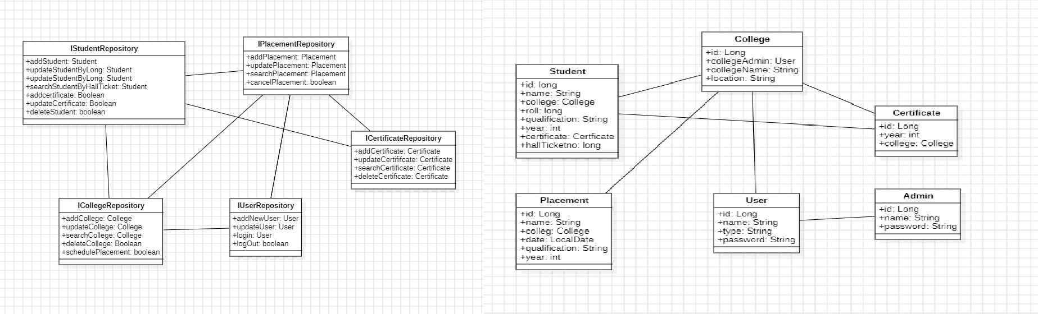
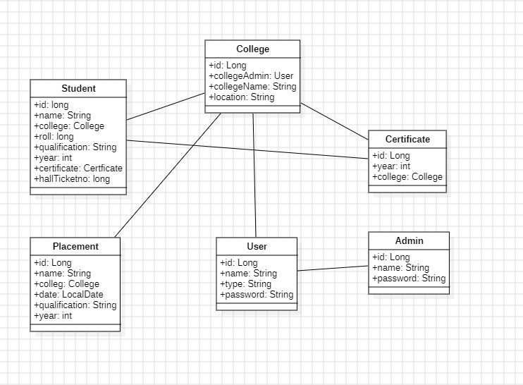
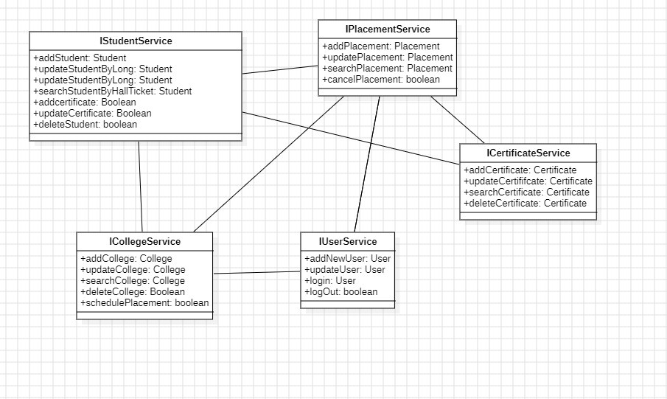

Slide 11

JPA Project Flow
Entities
Repository
Service
Client
Create Retrive
CRUD OPERATIONS
Update Delete

Slide 12


Use case Diagrams
Add student
data
Upload Certifica te
Login/Regi ster
University/ College
Schedule Placement Drive
Use case diagram for Corporate
Update Student Data
Search Students
Search
Student
Login
/ Regist er
View Certificat e
Use case diagram for University/Colleges
Corporate
Search for College/Unive rsity

Slide 13

Use case Diagrams
View Pending Corporate Registration Requests
Approv e/Reje ct Reques t
Login/ Regist er
Admin
View Pending University Registration Requests
Approve/R eject Request
Use case diagram for Admin

Slide 14
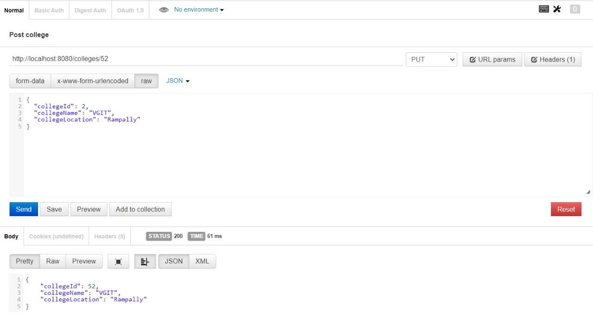

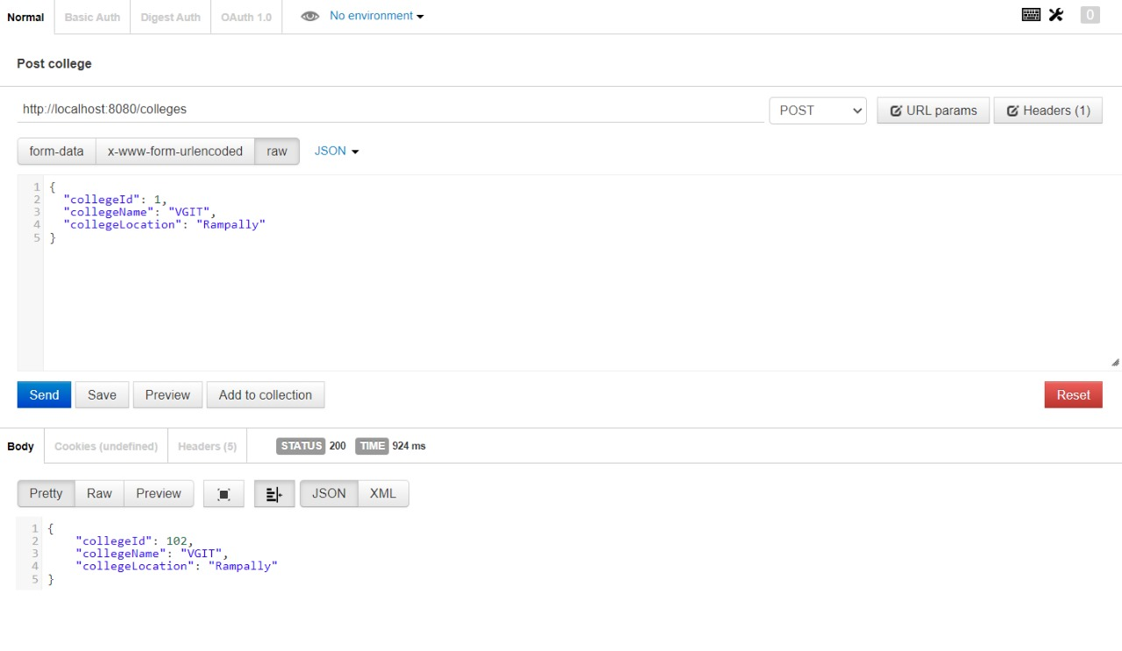
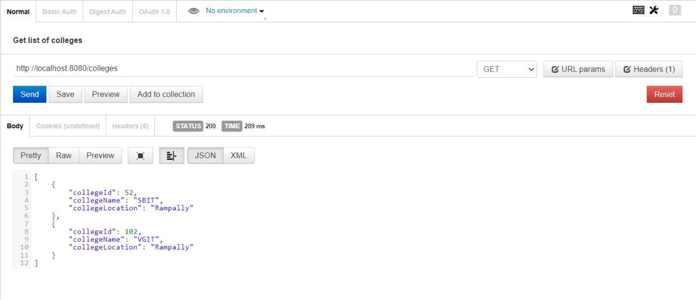
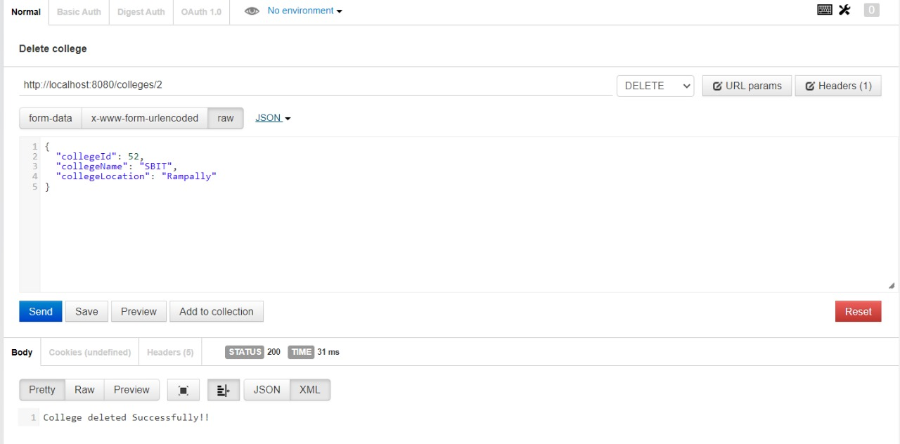
OUTPUT - College

Slide 15
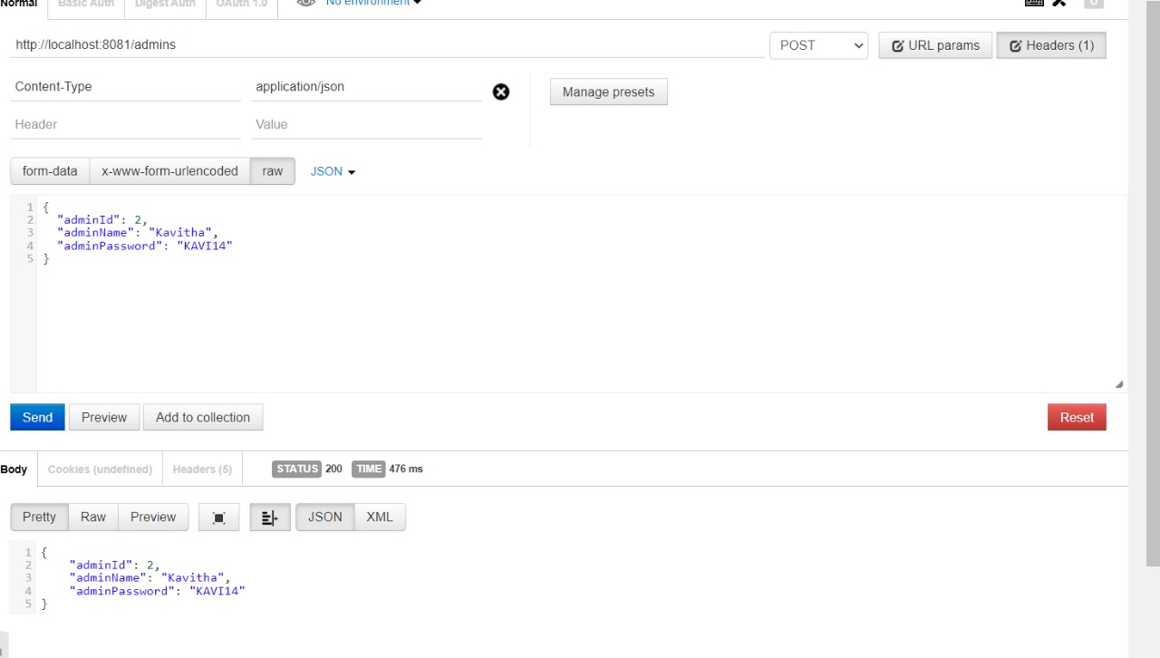
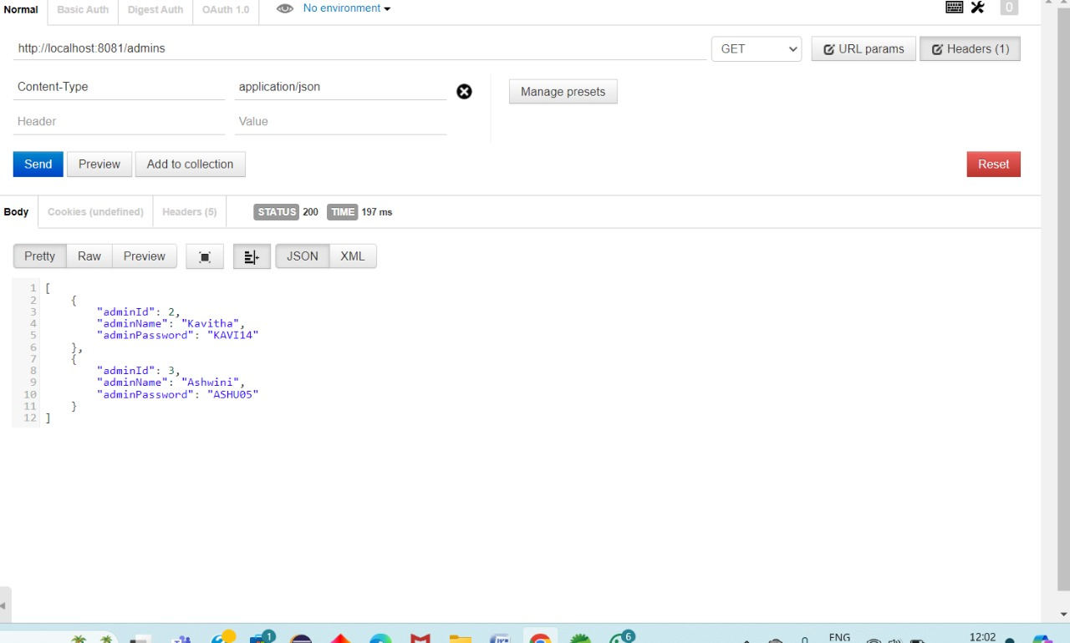
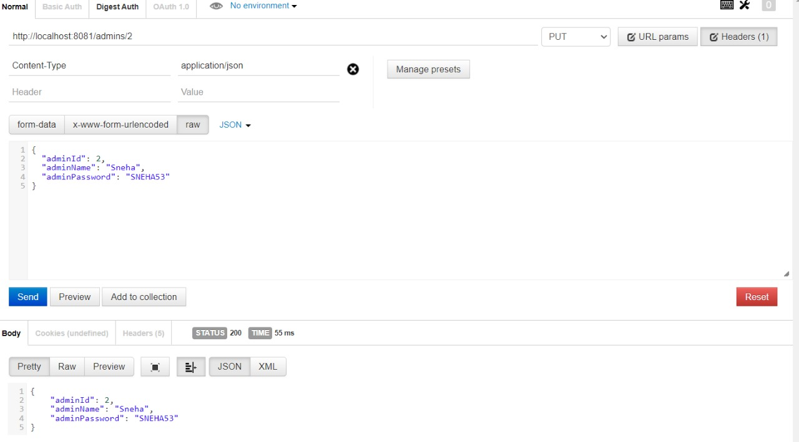
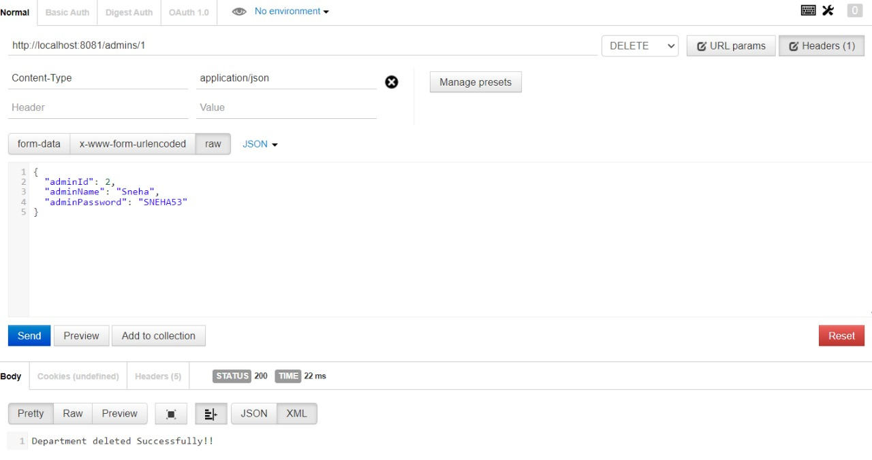
OUTPUT - Admin

Slide 16
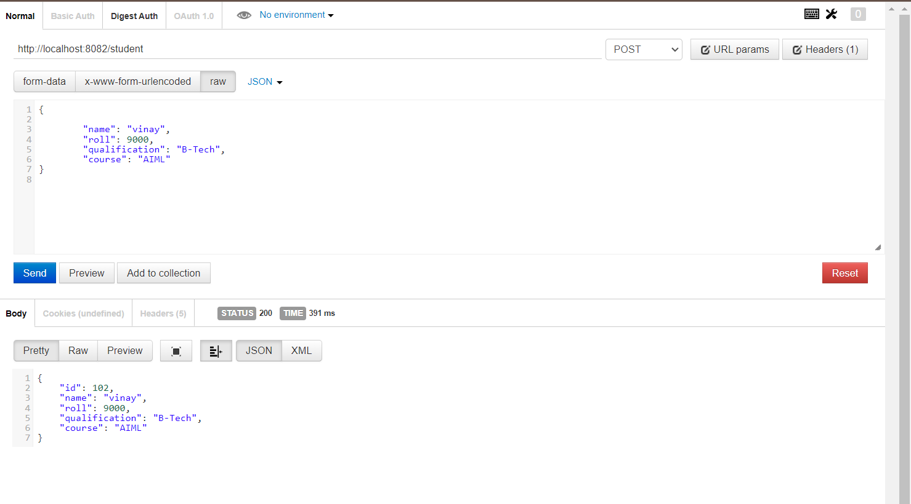
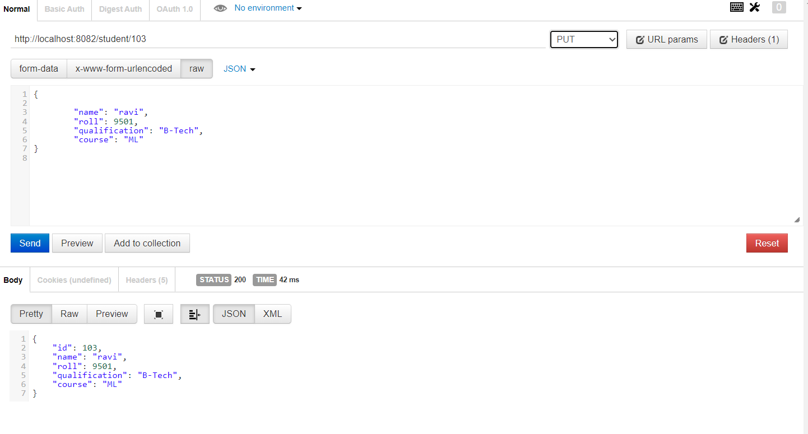
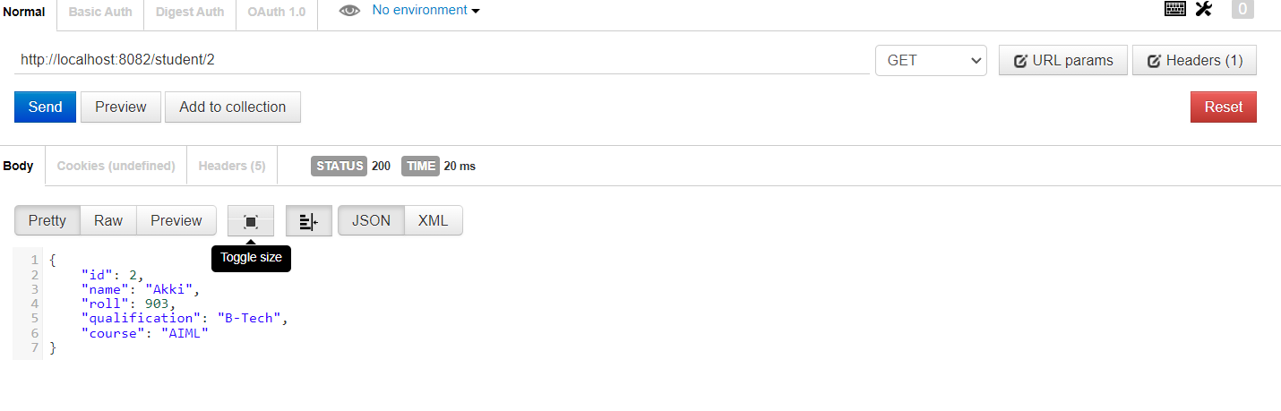
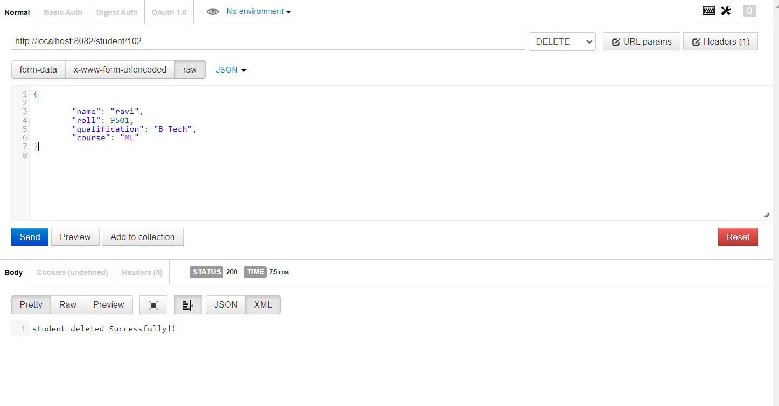
OUTPUT - Student
16

Slide 17
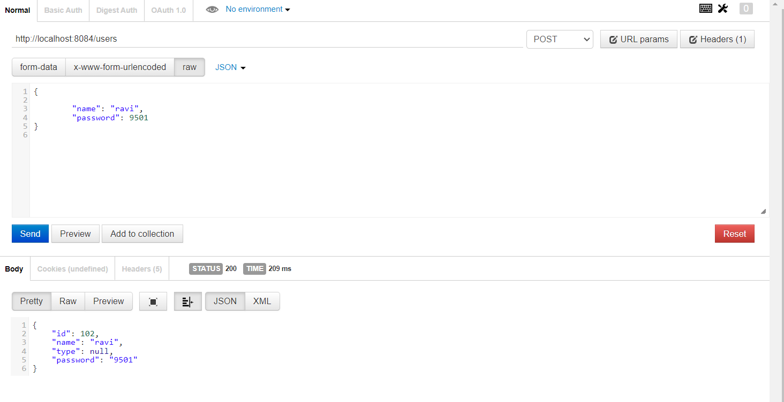
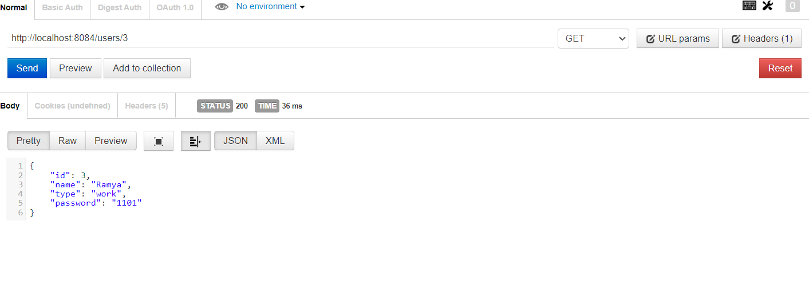
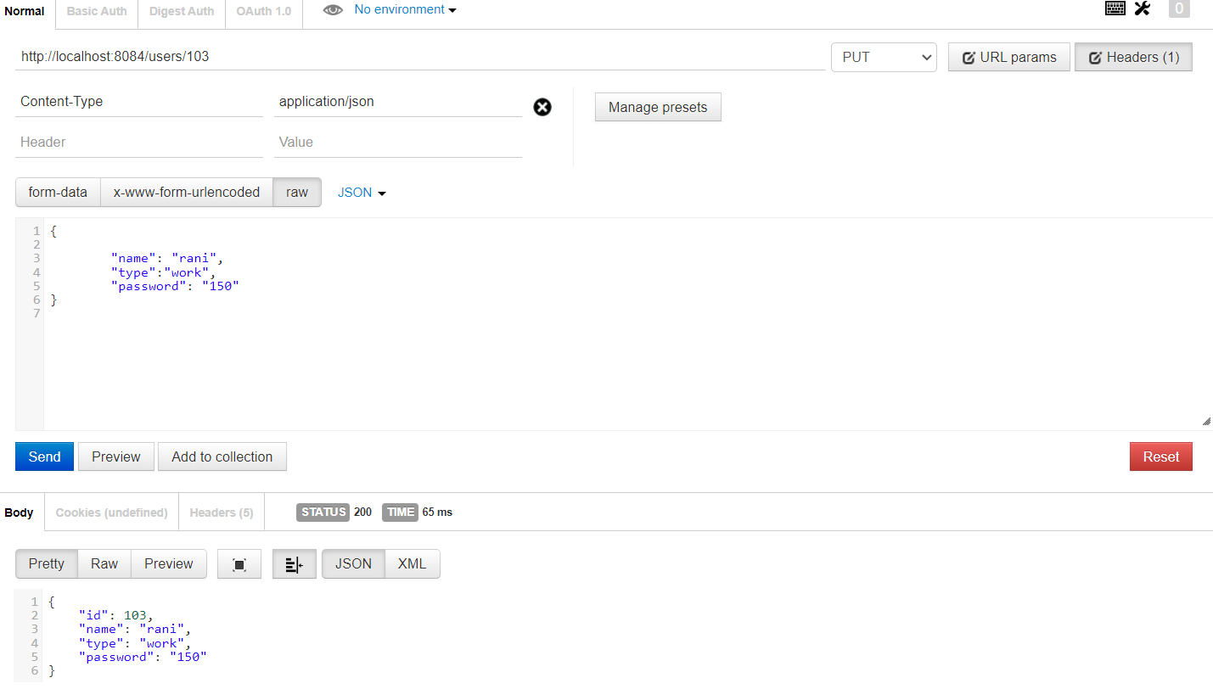
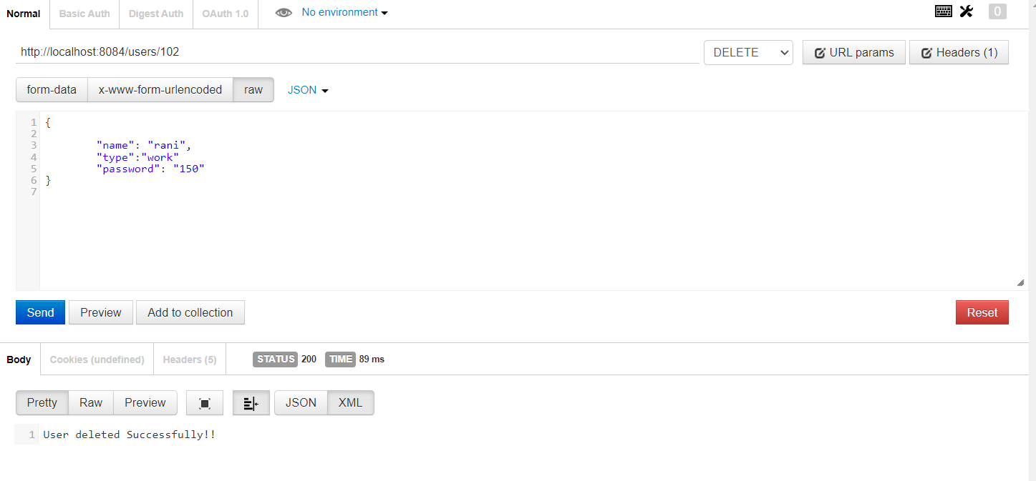
OUTPUT - User

Slide 18
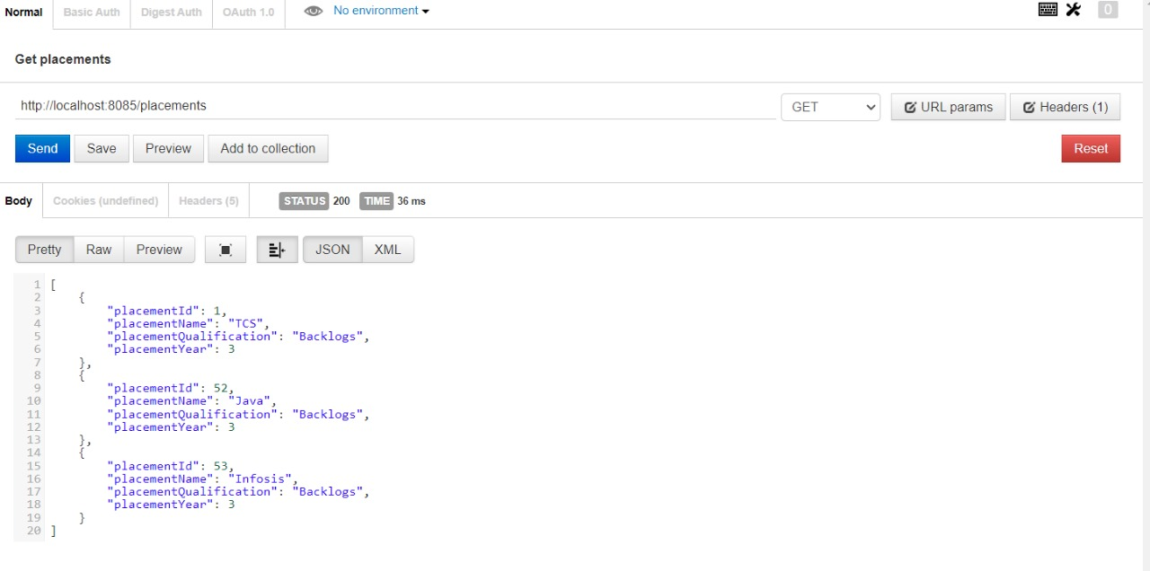
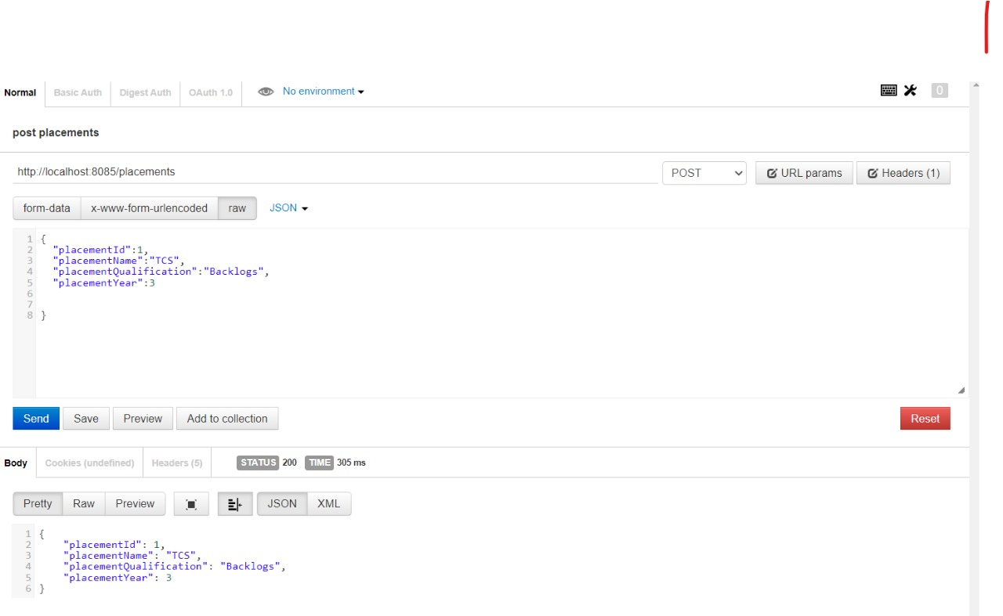
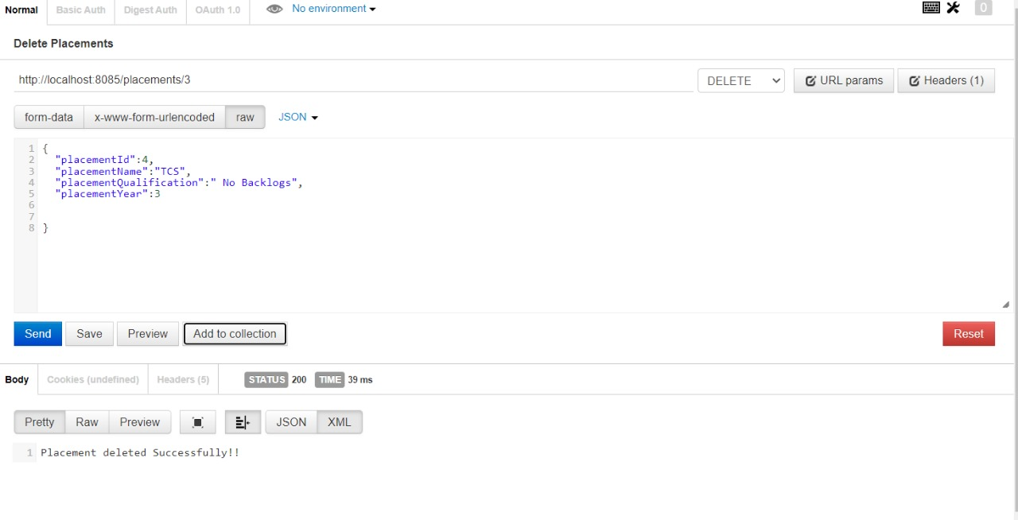
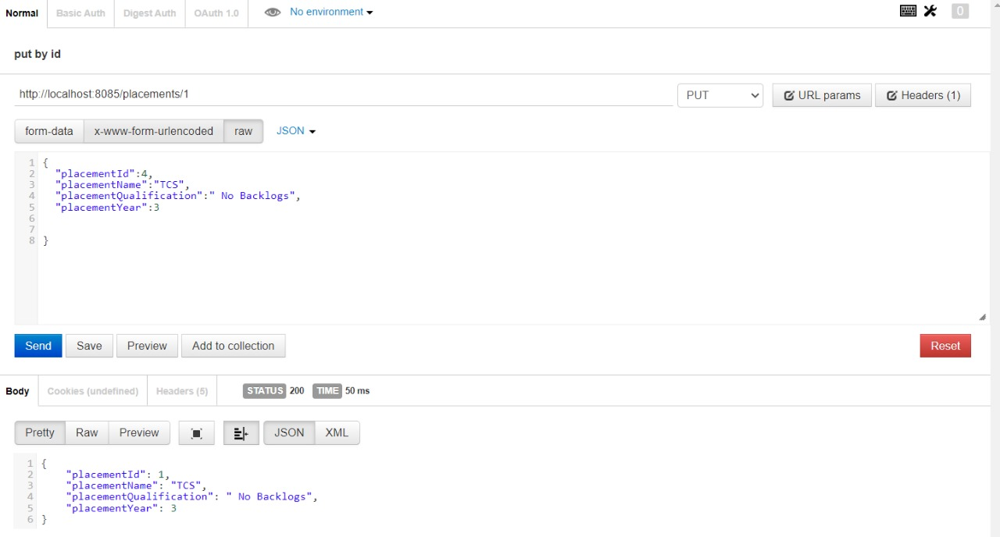
OUTPUT - Placement

Slide 19


